Slide 1

Clustering Analysis Movie Dataset
By Shimin

Slide 2


Outline
Data Preparation:
Check variables of dataset, identify dependent variable
Transform Categorical data to Numerical data through Get dummy function.
Normalized Data for unbiased analysis
Unsupervised-Learning Clustering Analysis:
Hierarchical Clustering
K-Means
K-medoids
Supervised-Learning Clustering Analysis:
K-NN
Support-Vector-Machine(SVM)
Binary Logistic Regression for factor exploration

Slide 3
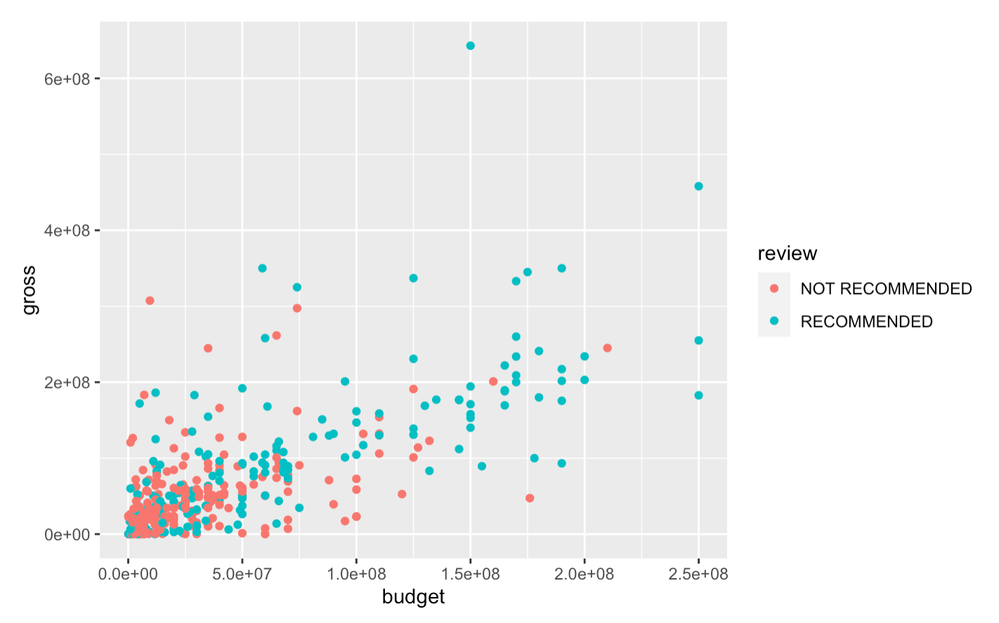
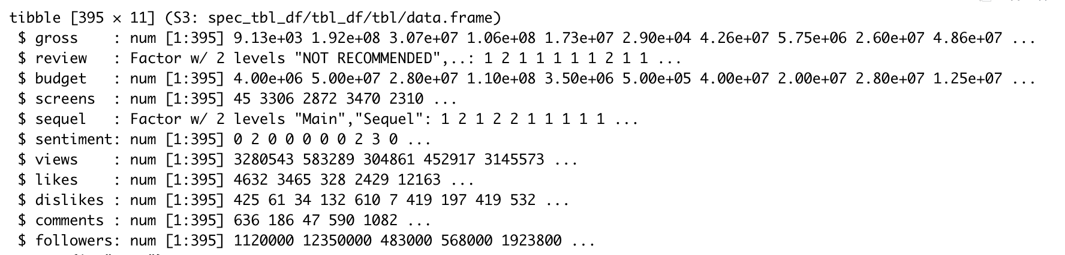
Data Preparation:
Firstly, let’s check the structure of this dataset. There are 396 datasets with 11 features in this movie dataset. Among all variables, there are two factor variables: Review, Sequel. Review is the dependent variable for this dataset. It has two levels: Recommend/Not Recommend. I will purposely remove this feature to let machine self—learning predicting classification of each item in this dataset; The other factor variable: sequel. It is the variable that with two levels. Since clustering can only deal with numerical variable, I will get dummy for this variable and remove first dummy column.

Slide 4
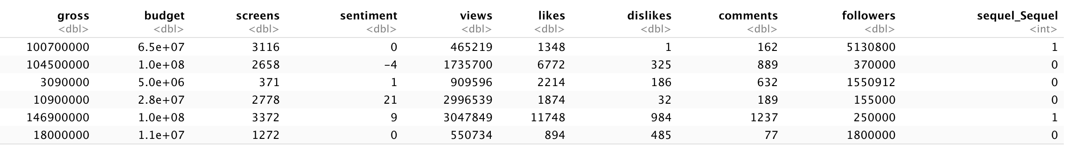
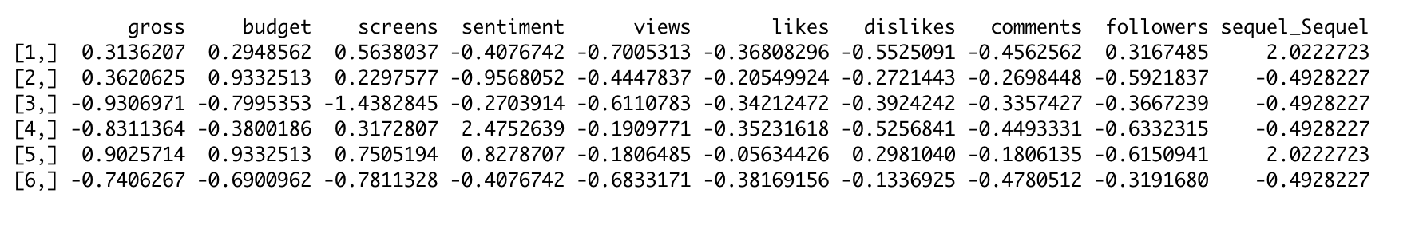
Data Preparation: Get Dummy & Normalized Numerical Value
After I confirmed that there is no null value in dataset, I get dummy for categorical variable.
Just as the sheet shown above, there are some big discrepancies on values of different features. I need to normalized the data before proceed to further analysis. I used standard deviation and mean to normalize the data and here is the snapshot of head of new movie features.

Slide 5
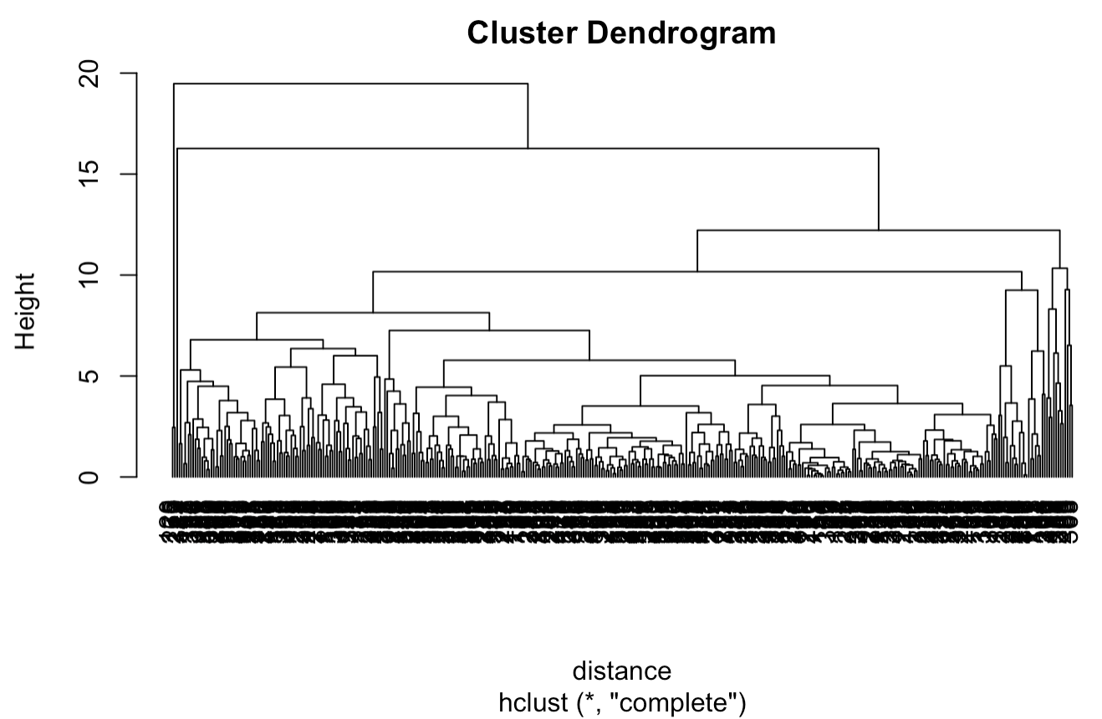
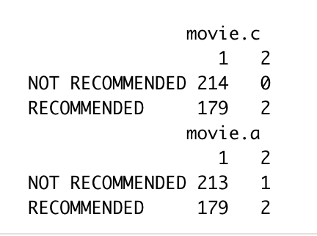
Unsupervised Learning - Hierarchical Clustering
The first clustering option I chose to apply is hierarchical clustering. I calculate Euclidean Distance and draw plot based upon complete linkage and average linkage. From the graph we can see that it disproportionally assign more rows to specific categories, which may indicate there are some significant false positive cases.

Slide 6
Hierarchical Clustering Influential Factors
For further reference, I checked factors affects its category. Top shows original value of movie features while bottom image shows normalized value. We can see a significant difference on dislikes, likes and vies. I identify these three features are the most influential factors affect final review.

Slide 7
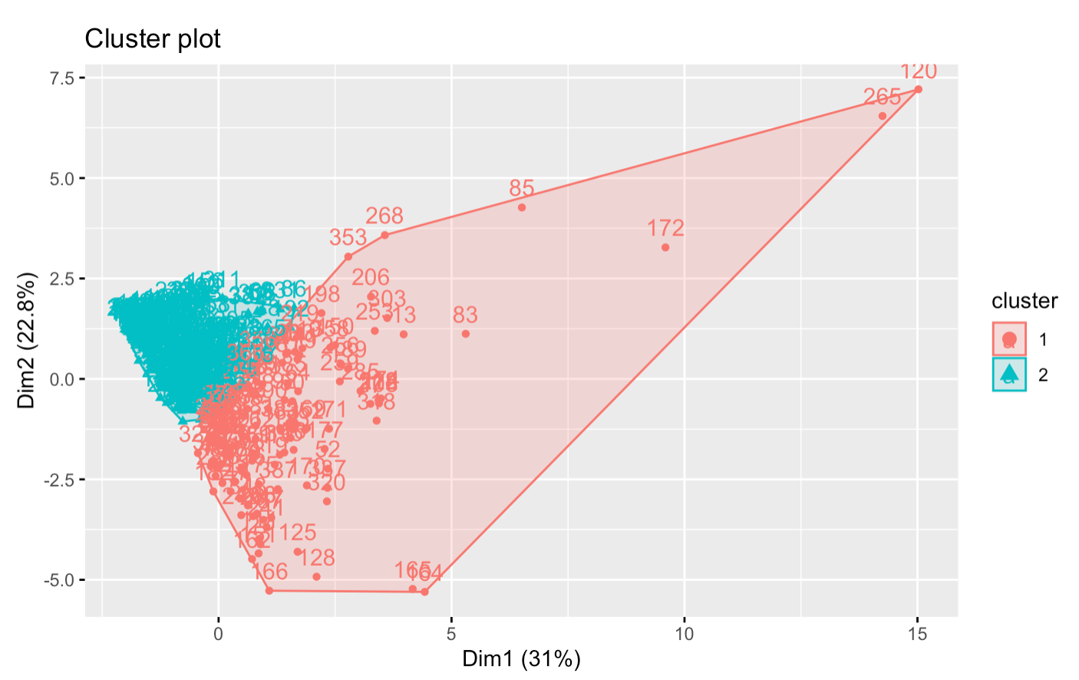
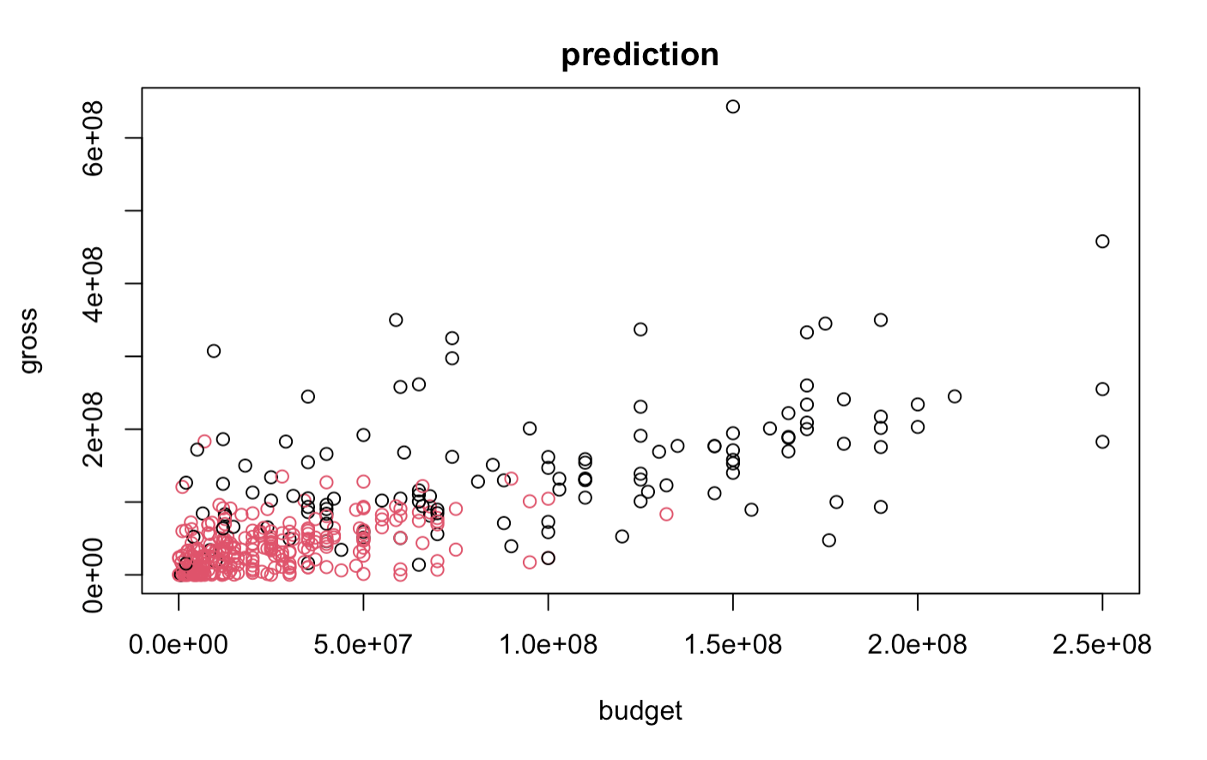
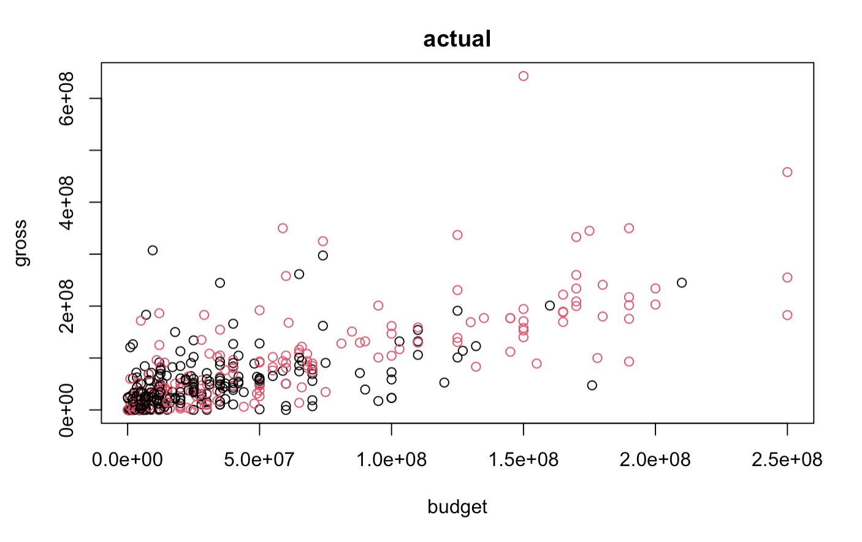
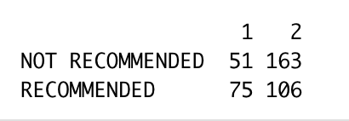
K-Means Clustering
The second approach I chose is K-Means clustering. Accuracy of K-Means Clustering increase a lot from Hierarchical clustering.

Slide 8
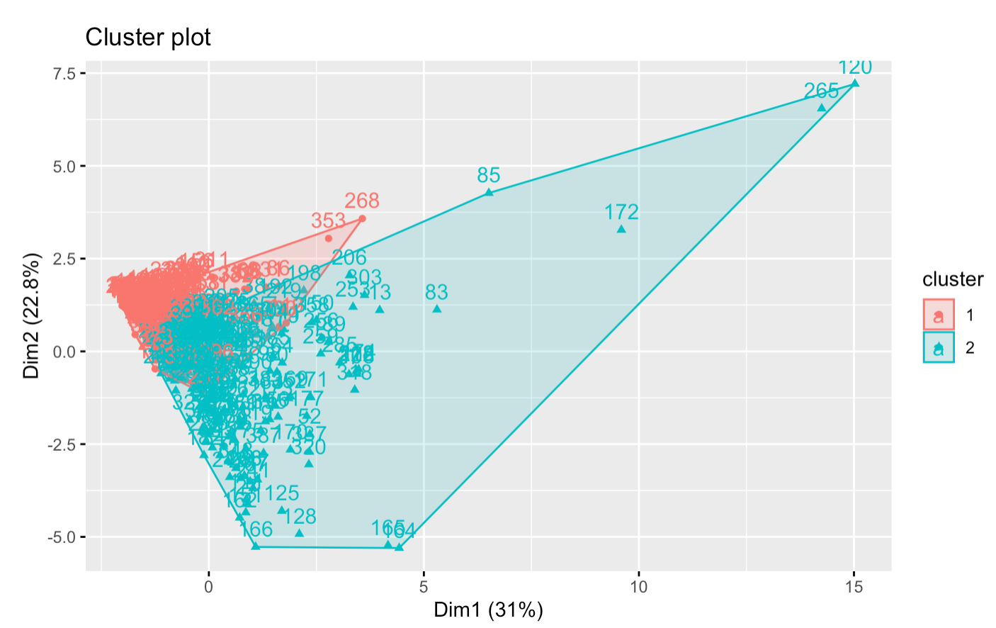
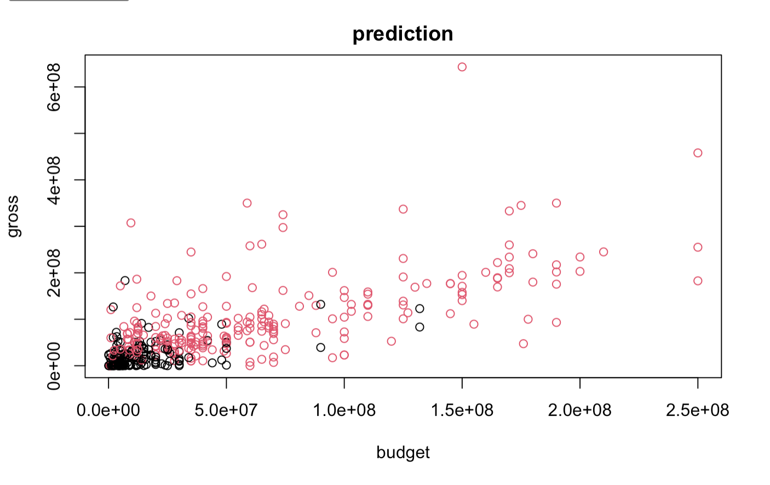
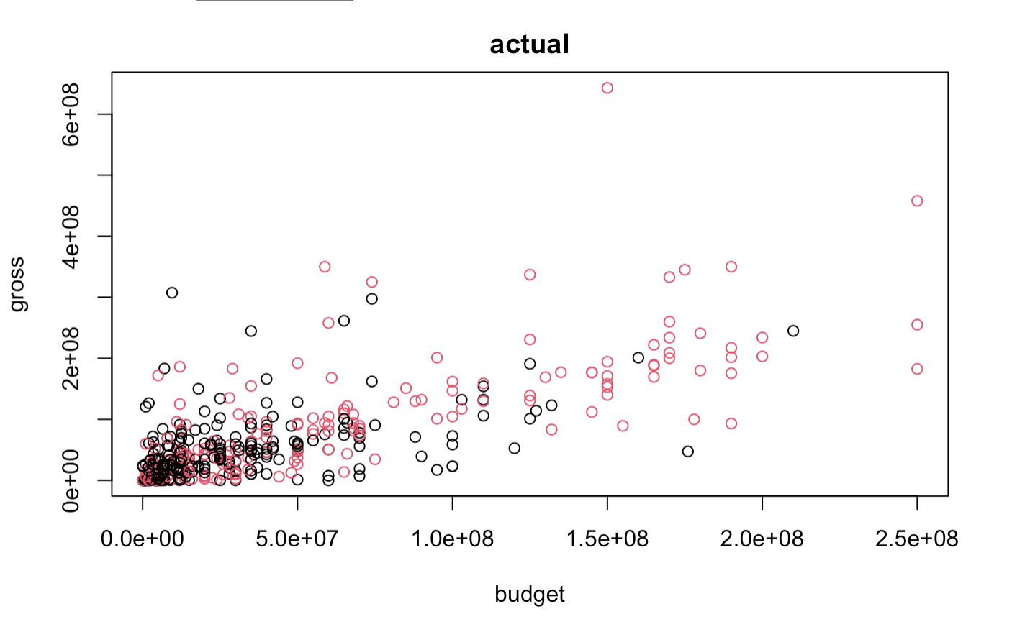
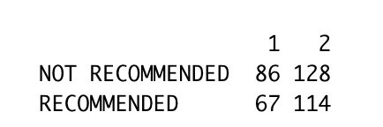
K-Medoids Clustering
The second approach I chose is K-Medoids clustering. Accuracy of K-Means Clustering performed the best among all unsupervised learning method.

Slide 9
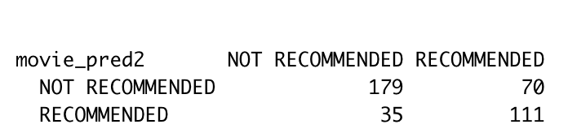
Supervised Learning: KNN Clustering
So far the unsupervised learning does not perform well here, so I tried supervised learning instead to do the clusteirng model.KNN clustering has higher accuracy in both training and test data than previous one. I split test and train data here to avoid overfitting issue.
Supervised Learning performed much better than unsupervised learning and accuracy has increased a lot for both categories.
I will try other supervised learning method in the following steps.

Slide 10
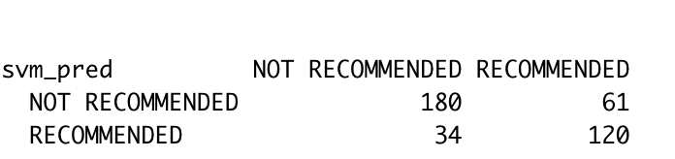
Supervised Learning: SVM Clustering
For SVM, I used the same train and test split in the previous method for comparison. SVM performed better than KNN in both train and test data. At this point of level, I will use SVM(Suport vector machine) as my final model for classification here.

Slide 11
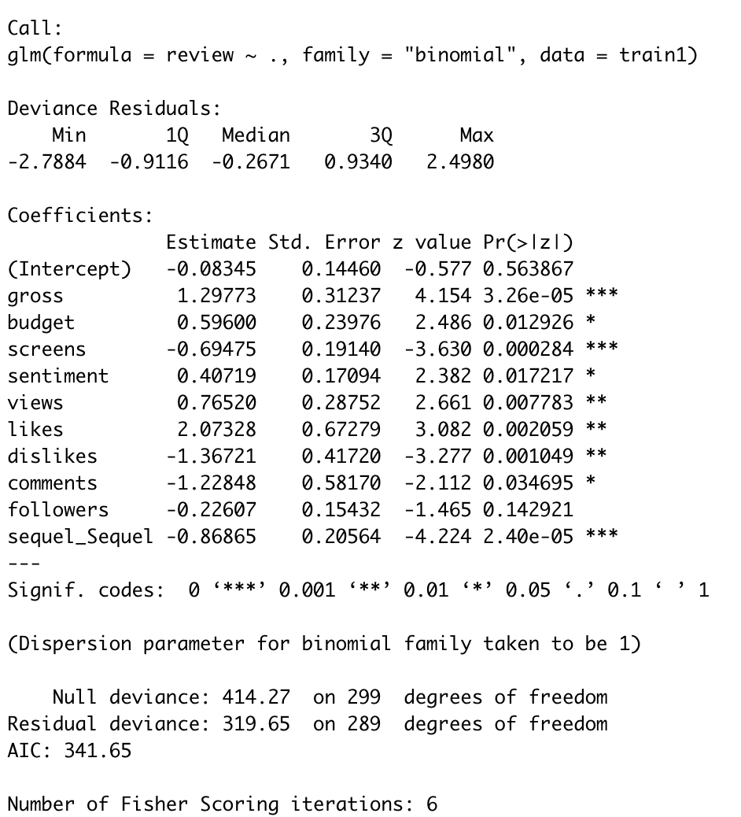
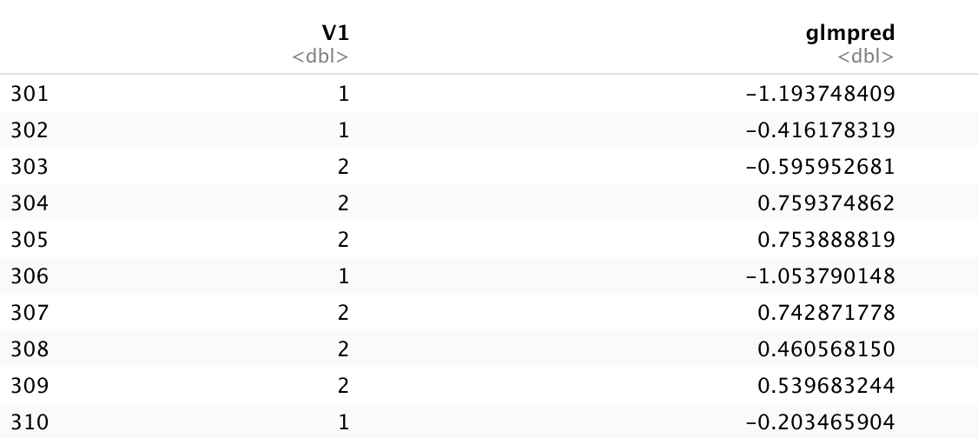
Supervised Learning: Logistic Regression for factor Exploration
For the last model, I will apply logistic regression. I used this because I know previously that it has two class and I could perform supervised learning on this dataset. The logistic model cannot directly predict classification but can offer me some insights on influential factors on the final prediction. Check summary of logistic model for further details. We can see that gross, screens and sequel are the most influential factors for prediction here.

Slide 12
Summary
In summary, I have applied both unsupervised learning algorithm method and supervised learning algorithm here. Among all unsupervised clustering methods, K-medoids performed the best; Among all supervised clustering method, SVM performed best. Overall, supervised learning method has much higher accuracy than that of unsupervised algorithm. My final model selection is SVM model. Logistic Regression were applied for further exploration on factors, especially those influential one. It turns out that gross, screens and sequel are the most influential factors affect the final prediction.

Slide 13
Thank You

